Slide 1


Commercial Finance Solutions
Textile and Apparel
October 2011

Slide 2

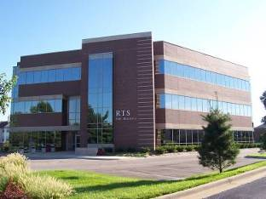
Corporate Overview
  Privately Held Company Founded in 1986
  2010 Corporate Gross Revenues $1.5 Billion
  2011 Forecast $1.75 Billion
  30% of Transactional Volume is Cross-Border
  Industry Expertise:
    Transportation
    Soft Commodities
    Agriculture
    Seafood
    Manufacturing
    Textile & Apparel
CONFIDENTIAL
Notes:
2

Slide 3
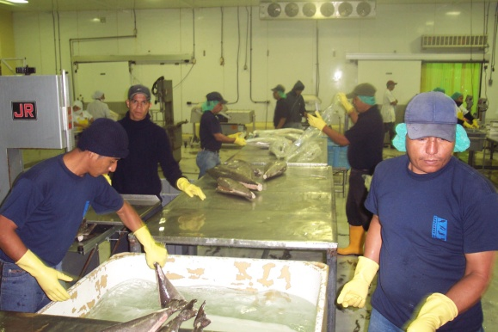
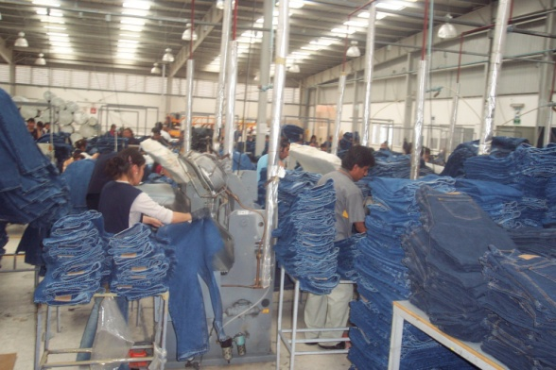

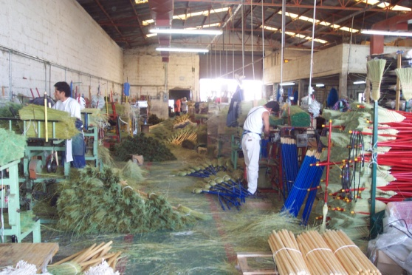
Client Locations
RTS International partners with clients around the world in a variety of industries:
  Canada
  Chile
  Colombia
  Costa Rica
  Ecuador
  Honduras
  India
  Israel
  Mexico
  Nicaragua
  Panama
  Peru
  Uruguay
  United States
CONFIDENTIAL
Notes:
3

Slide 4
Industry Challenges – Textile & Apparel
Full-Package has Transferred Working Capital Burden to Small Vendors
Dynamic Unstable Global Financial Markets
Drastic Cost Increase in
Raw Materials
(Cotton & Synthetics)
Reduction or Elimination of Traditional Lines of Credit
CONFIDENTIAL
Notes:
4
4

Slide 5
Existing Financial Options
Traditional Banking
Cumbersome & Inflexible
Cash Flow Provided By Buyer
Payables Facility
Commercial Finance
Flexible, Nimble
Difficult To Obtain, Bureaucratic
Letters of Credit
Access to Capital for SMEs
Can Be Inexpensive
Requires Use of Buyer’s Balance Sheet
Transactional Finance
Advance Payments
Not constrained by Banking Regulations
CONFIDENTIAL

Slide 6
Commercial Finance vs. Traditional Banking
Commercial Finance
Customized Solutions to meet specific funding needs
Access to capital increases as sales grow
Speed to funding – Fast & Easy account set-up
  Client’s Credit Line is Not Restricted by Traditional Measures of
  Financial Strength, but rather on Buyer’s Strength
  Collateral typically limited to receivables
  Flexible, transactional funding
Traditional Banking
Limited access to capital
Involved underwriting process and lengthy account set-up
Cumbersome reporting requirements, financial covenants
Credit availability tied to company’s balance sheet, fixed assets, etc.
Restrictions against cross-border risk
Lack of flexibility

Slide 7


From a start-up to public offering
Small-to-Middle Market Companies
f&f
angel
equity
early stage VC
mid stage VC
late stage VC
private equity
public offering
mezzanine finance / real estate / leasing
private note
structured debt
supplier financing
bridge
bridge
bridge
bridge
debt
term debt
asset based loan / receivable financing
convertible note
factoring & P.O. financing
+
early stage
pre-production
Characteristically high in burn with little or no revenue
start-up stage
production begins
Characteristically high in burn with little or no revenue
early-mid stage
approaches EBITDA
Characteristically high in burn with steadily increasing revenue
mid stage
revenue reaches EBITDA
Characteristically steadily increase in revenue and expenses
mature stage
reduced growth
Characteristic revenue and expense begin to level
Money
SG&A
EBITDA positive
expenses
cost of goods sold
revenue
0
Time
+
The Financing Stages from Start-up to Public Offering
Source: CEO Advisors
The Dilemmas faced by apparel manufacturers and their solutions

Slide 8
Commercial Finance - Structures
  Factoring
    Funding against confirmed receivables. Components may include Advance Rate, Interest Rate, Processing Fee / Commission, other charges may apply. May be “Recourse” or “Non-Recourse”
  Payables Facility
    Funding / early payment provided to vendors on behalf of Buyer. Typically requires some form of agreement / guaranty from the Buyer
  Purchase Order
    Funding provided against value of Purchase Order. Components will include Advance Rate, Interest Rate, Processing Fee / Commission. Should also anticipate receivables as collateral
Notes:
8

Slide 9

For Additional Information please contact:
Justin Goheen
Director of Business Development
Tel: 317-841-2722 | Mobile: 317-294-0159
Email: jgoheen@rtsfinancial.com
Notes:
9

